Slide 1
Posterior Cramer-Rao Bounds for Discrete-Time Nonlinear Filtering
P. Tichavsky; C.H. Muravchik; A. Nehorai

Slide 2
Table of Contents

Slide 3
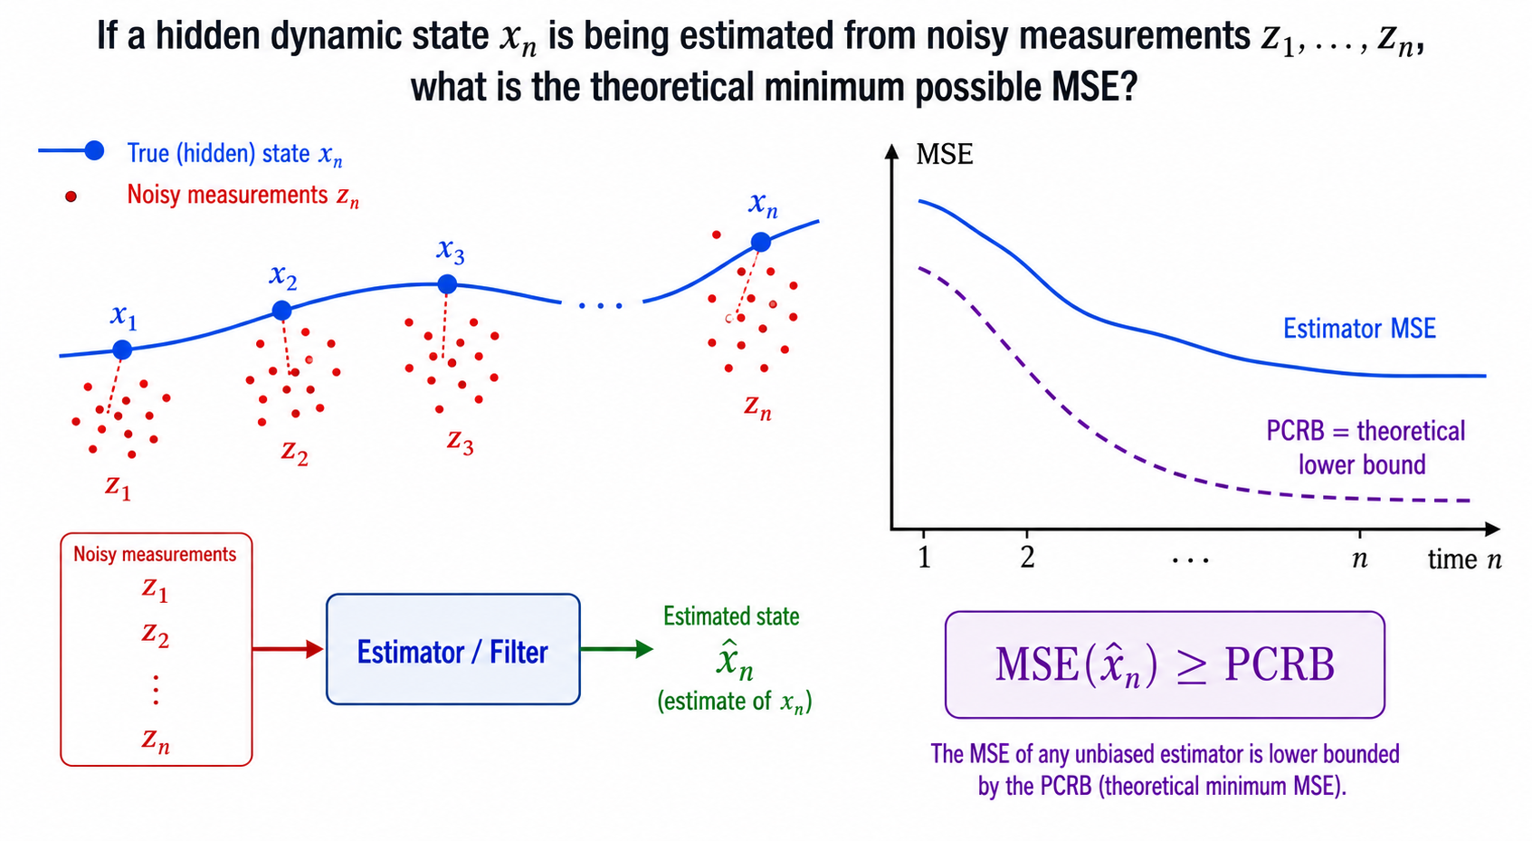
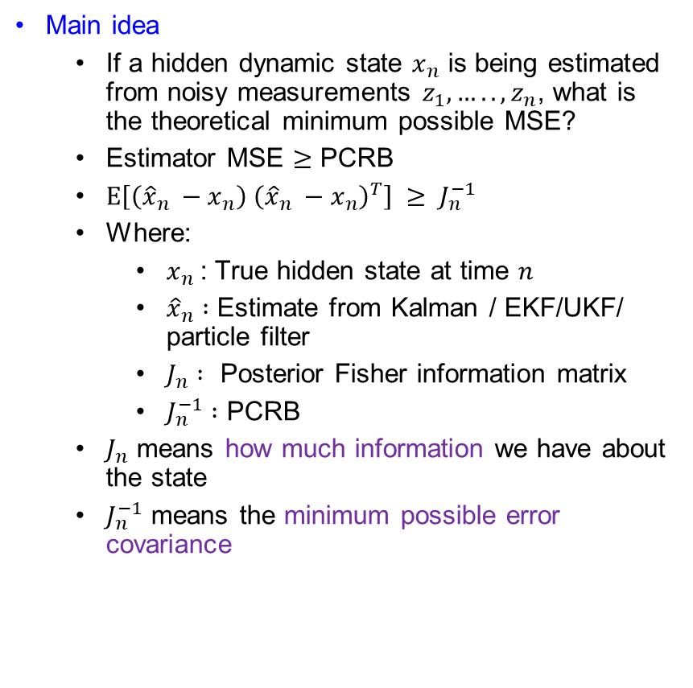
PCRB for Tracking or Filtering
Main idea
  If a hidden dynamic state $x_{n}$ is being estimated from noisy measurements $z_{1},…..,z_{n}$, what is the theoretical minimum possible MSE?
  Estimator MSE $≥$ PCRB
  $E\left[\left({\hat{x}}_{n} −x_{n}\right) {\left({\hat{x}}_{n} −x_{n}\right)}^{T}\right] ≥ J_{n}^{−1}$
  Where:
    $x_{n}$: True hidden state at time $n$
    ${\hat{x}}_{n} :$ Estimate from Kalman / EKF/UKF/ particle filter
    $J_{n} :$ Posterior Fisher information matrix
    $J_{n}^{−1} :$ PCRB
  $J_{n}$ means how much information we have about the state
  $J_{n}^{−1}$ means the minimum possible error covariance

Slide 4
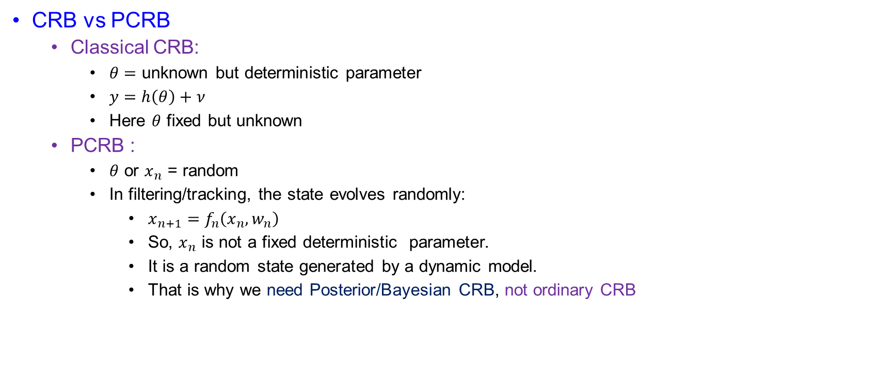
PCRB for Tracking or Filtering
CRB vs PCRB
  Classical CRB:
    $θ=$ unknown but deterministic parameter
    $y=h\left(θ\right)+ν$
    Here $θ$ fixed but unknown
  PCRB :
    $θ$ or $x_{n}$ = random
    In filtering/tracking, the state evolves randomly:
      $x_{n+1}=f_{n}\left(x_{n}, w_{n}\right)$
      So, $x_{n}$ is not a fixed deterministic parameter.
      It is a random state generated by a dynamic model.
      That is why we need Posterior/Bayesian CRB, not ordinary CRB

Slide 5
PCRB for Tracking or Filtering
Probability Recap
Concepts | Meaning
Prior | What we know before measurement
Likelihood | Probability of measurement given state
Posterior | Update belief after measurement
Fisher information | Curvature/ sharpness of log probability
Covariance | Estimation uncertainty
Hessian | Matrix of second derivative
PSD inequality | Matrix version of “greater than or equal”

Slide 6

PCRB for Tracking or Filtering
Probability Recap
  Bayesian chain:
    $p\left(θ | x\right)= \frac{p\left(x \right|θ)p\left(θ\right)}{p\left(x\right)}$
    $p\left(θ\right):$ prior information
    $p\left(x | θ\right):$ data information
    $p\left(θ | x\right):$ posterior information
  PCRB is based on the posterior information.

Slide 7
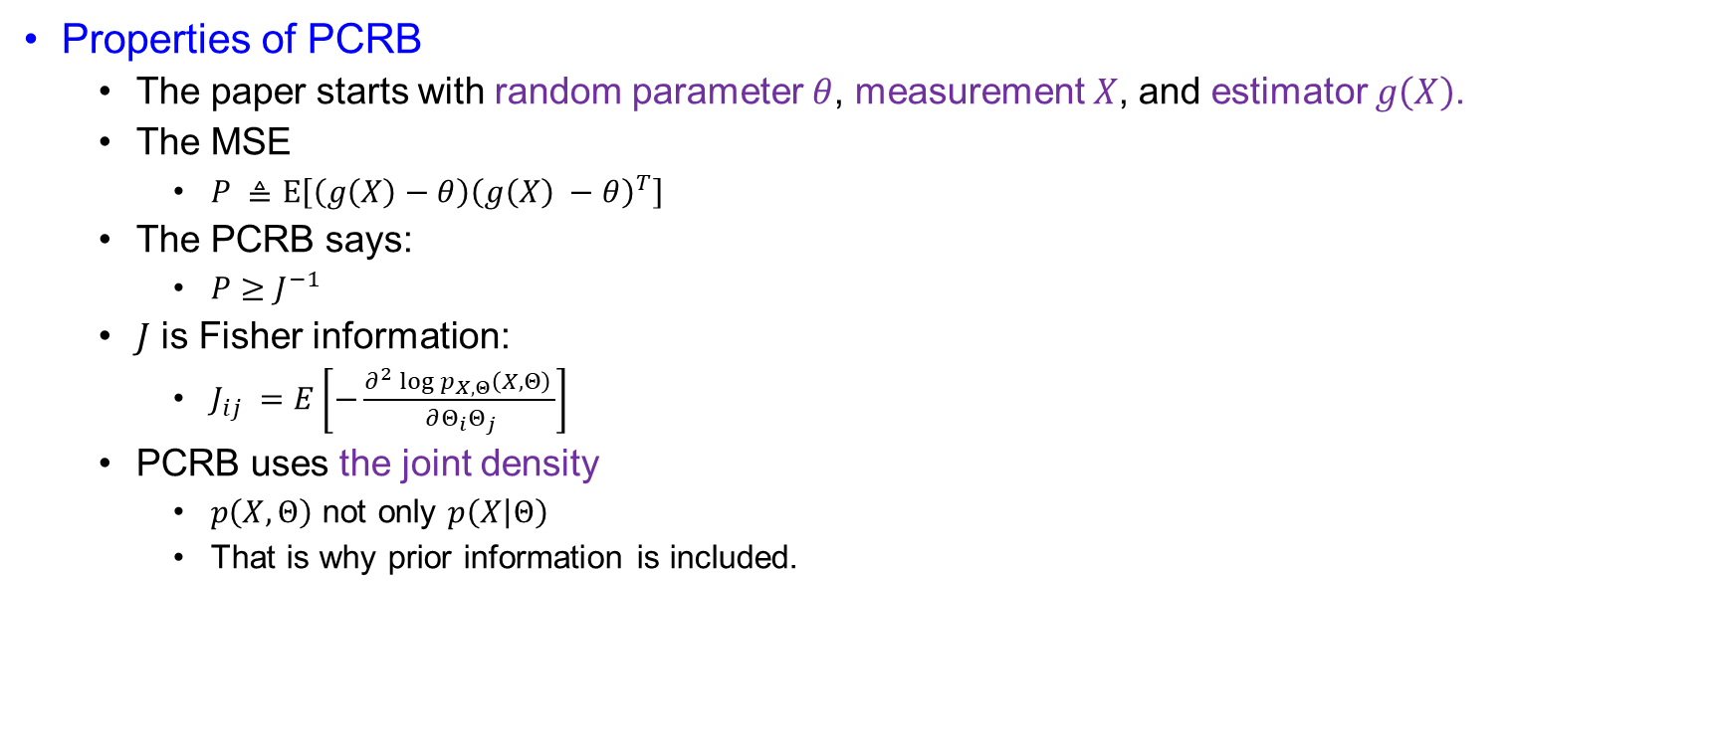
PCRB for Tracking or Filtering
Properties of PCRB
  The paper starts with random parameter $θ$, measurement $X$, and estimator $g\left(X\right)$.
  The MSE
    $P ≜E\left[\left(g\left(X\right)−θ\right){\left(g\left(X\right) −θ\right)}^{T}\right]$
  The PCRB says:
    $P≥J^{−1}$
  $J$ is Fisher information:
    $J_{ij} =E\left[−\frac{∂^{2}\log{p_{X,Θ}\left(X,Θ\right) }}{∂Θ_{i}Θ_{j}}\right]$
  PCRB uses the joint density
    $p\left(X,Θ\right)$ not only $p\left(X | Θ\right)$
    That is why prior information is included.

Slide 8
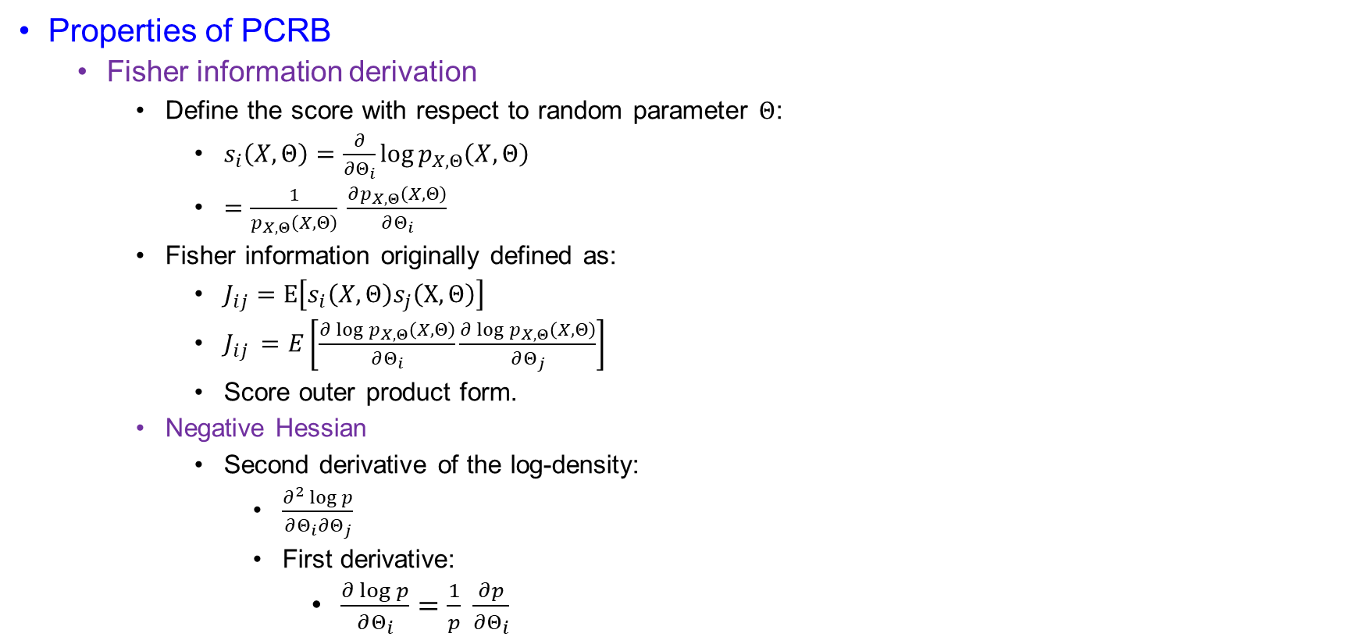
PCRB for Tracking or Filtering
Properties of PCRB
  Fisher information derivation
    Define the score with respect to random parameter $Θ$:
      $s_{i}\left(X,Θ\right)=\frac{∂}{∂Θ_{i}}\log{p_{X,Θ}\left(X,Θ\right)}$
      $=\frac{1}{p_{X,Θ}\left(X,Θ\right)} \frac{∂p_{X,Θ}\left(X,Θ\right)}{∂Θ_{i}}$
    Fisher information originally defined as:
      $J_{ij}=E\left[s_{i}\left(X,Θ\right)s_{j}\left(X,Θ\right)\right]$
      $J_{ij }=E\left[\frac{∂\log{p_{X,Θ}\left(X,Θ\right)}}{∂Θ_{i}}\frac{∂\log{p_{X,Θ}\left(X,Θ\right)}}{∂Θ_{j}}\right]$
      Score outer product form.
    Negative Hessian
      Second derivative of the log-density:
        $\frac{∂^{2}\log{p}}{∂Θ_{i}∂Θ_{j}}$
        First derivative:
          $\frac{∂\log{p}}{∂Θ_{i}}=\frac{1}{p} \frac{∂p}{∂Θ_{i}}$

Slide 9
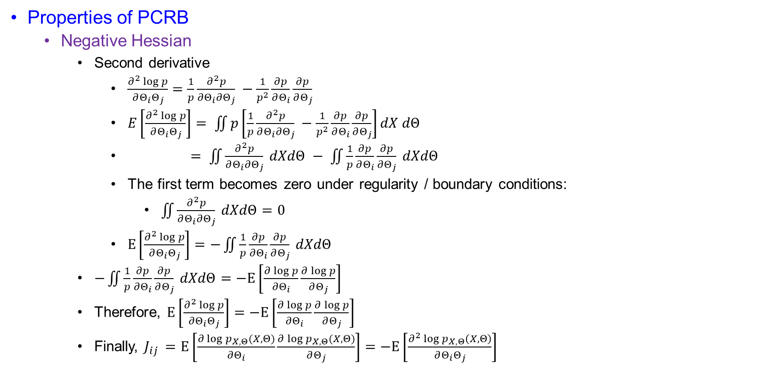
PCRB for Tracking or Filtering
Properties of PCRB
  Negative Hessian
    Second derivative
      $\frac{∂^{2}\log{p}}{∂Θ_{i}Θ_{j}}=\frac{1}{p}\frac{∂^{2}p}{∂Θ_{i}∂Θ_{j}} −\frac{1}{p^{2}}\frac{∂p}{∂Θ_{i}}\frac{∂p}{∂Θ_{j}}$
      $E\left[\frac{∂^{2}\log{p}}{∂Θ_{i}Θ_{j}}\right]= \iint{p\left[\frac{1}{p}\frac{∂^{2}p}{∂Θ_{i}∂Θ_{j}} −\frac{1}{p^{2}}\frac{∂p}{∂Θ_{i}}\frac{∂p}{∂Θ_{j}}\right]dX dΘ}$
      $= \iint{\frac{∂^{2}p}{∂Θ_{i}∂Θ_{j}} dXdΘ − \iint{\frac{1}{p}}}\frac{∂p}{∂Θ_{i}}\frac{∂p}{∂Θ_{j}} dXdΘ$
      The first term becomes zero under regularity / boundary conditions:
        $\iint{\frac{∂^{2}p}{∂Θ_{i}∂Θ_{j}} dXdΘ}=0$
      $E\left[\frac{∂^{2}\log{p}}{∂Θ_{i}Θ_{j}}\right]=−\iint{\frac{1}{p}\frac{∂p}{∂Θ_{i}}\frac{∂p}{∂Θ_{j}} dXdΘ}$
    $−\iint{\frac{1}{p}\frac{∂p}{∂Θ_{i}}\frac{∂p}{∂Θ_{j}} dXdΘ}=−E\left[\frac{∂\log{p}}{∂Θ_{i}}\frac{∂\log{p}}{∂Θ_{j}}\right]$
    Therefore, $E\left[\frac{∂^{2}\log{p}}{∂Θ_{i}Θ_{j}}\right]=−E\left[\frac{∂\log{p}}{∂Θ_{i}}\frac{∂\log{p}}{∂Θ_{j}}\right]$
    Finally, $J_{ij }=E\left[\frac{∂\log{p_{X,Θ}(X,Θ)}}{∂Θ_{i}}\frac{∂\log{p_{X,Θ}(X,Θ)}}{∂Θ_{j}}\right]=−E\left[\frac{∂^{2}\log{p_{X,Θ}}\left(X,Θ\right)}{∂Θ_{i}Θ_{j}}\right]$

Slide 10

PCRB for Tracking or Filtering
Information Decomposition
  The paper shows:
    $J=J_{D}+J_{P}$
    Where :
      $J_{D}=E[−∆_{Θ}^{Θ}\log{p\left(X \right|Θ)]}$
      $J_{P}=E\left[−∆_{Θ}^{Θ}\log{p\left(Θ\right)}\right]$
      $J_{D}=information from measurements$
      $J_{P}=information from prior$
      $J =total posterior information$
    Better measurements increases $J_{D}$.
    Stronger prior knowledge increases $J_{P}$.
    Larger $J$ means smaller PCRB.
    $PCRB =J^{−1}$

Slide 11
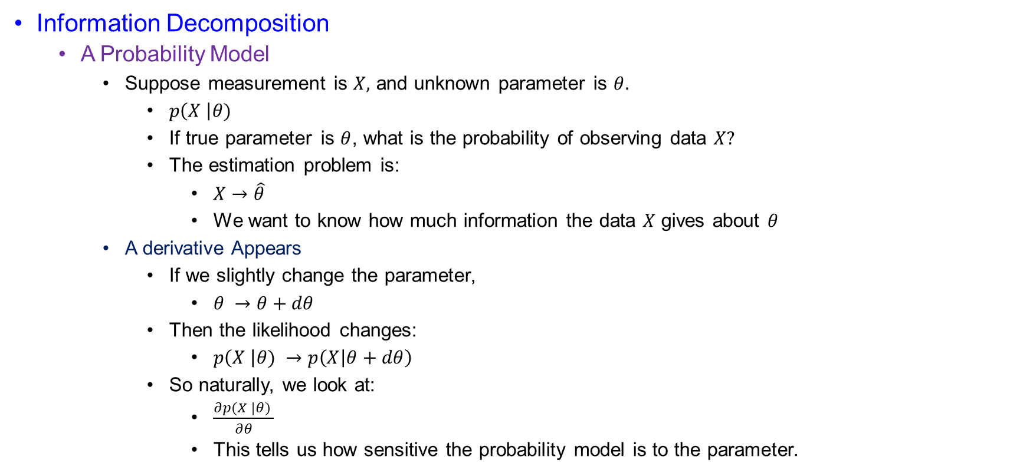
PCRB for Tracking or Filtering
Information Decomposition
  A Probability Model
    Suppose measurement is $X,$ and unknown parameter is $θ.$
      $p\left(X \right|θ)$
      If true parameter is $θ$, what is the probability of observing data $X?$
      The estimation problem is:
        $X→\hat{θ}$
        We want to know how much information the data $X$ gives about $θ$
    A derivative Appears
      If we slightly change the parameter,
        $θ →θ+dθ$
      Then the likelihood changes:
        $p\left(X \right|θ) →p\left(X | θ+dθ\right)$
      So naturally, we look at:
        $\frac{∂p(X |θ) }{∂θ}$
        This tells us how sensitive the probability model is to the parameter.

Slide 12
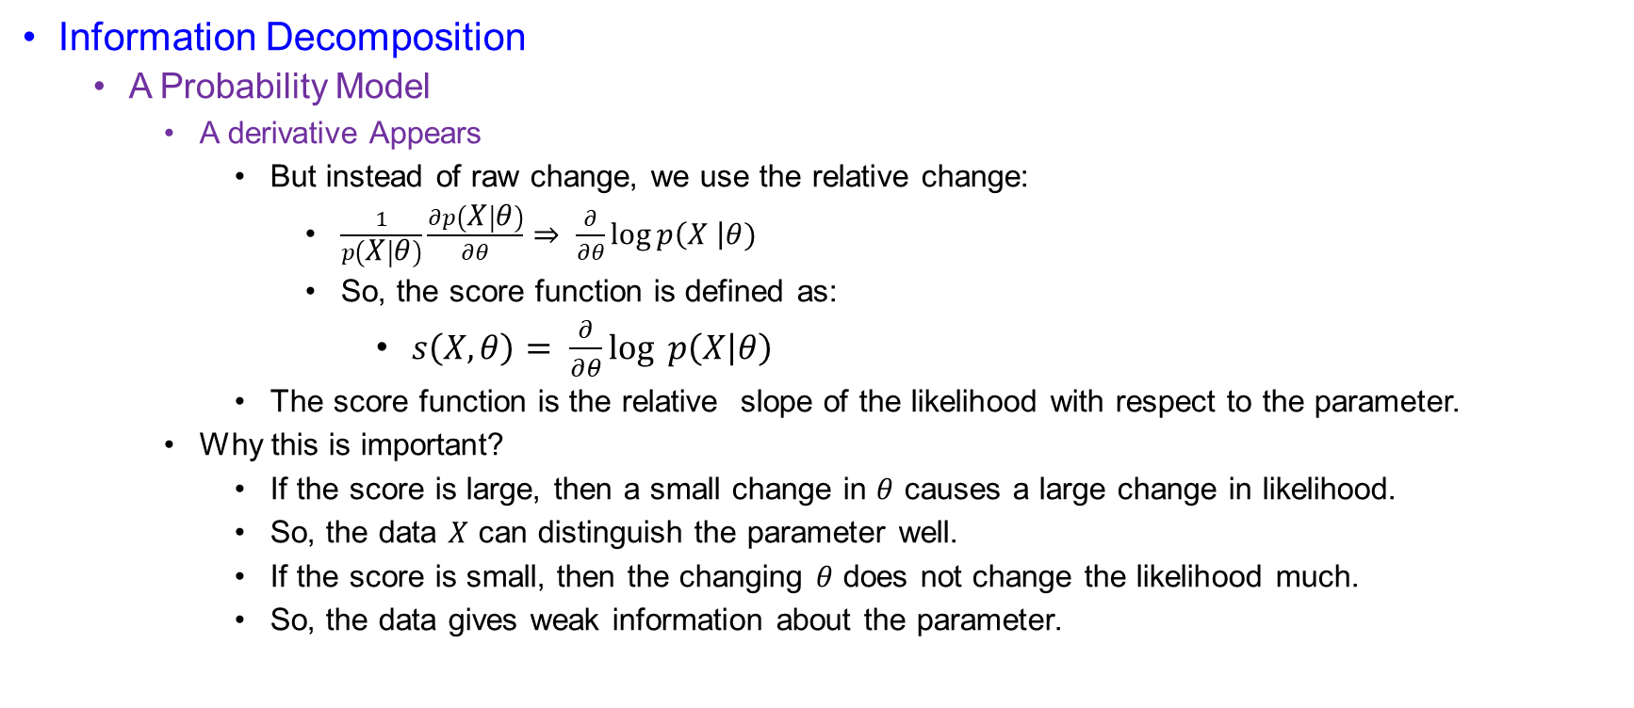
PCRB for Tracking or Filtering
Information Decomposition
  A Probability Model
    A derivative Appears
      But instead of raw change, we use the relative change:
        $\frac{1}{p\left(X | θ\right)}\frac{∂p\left(X | θ\right)}{∂θ}⇒ \frac{∂}{∂θ}\log{p\left(X \right|θ)}$
        So, the score function is defined as:
          $s\left(X,θ\right)= \frac{∂}{∂θ}\log{p\left(X | θ\right)}$
      The score function is the relative slope of the likelihood with respect to the parameter.
    Why this is important?
      If the score is large, then a small change in $θ$ causes a large change in likelihood.
      So, the data $X$ can distinguish the parameter well.
      If the score is small, then the changing $θ$ does not change the likelihood much.
      So, the data gives weak information about the parameter.

Slide 13
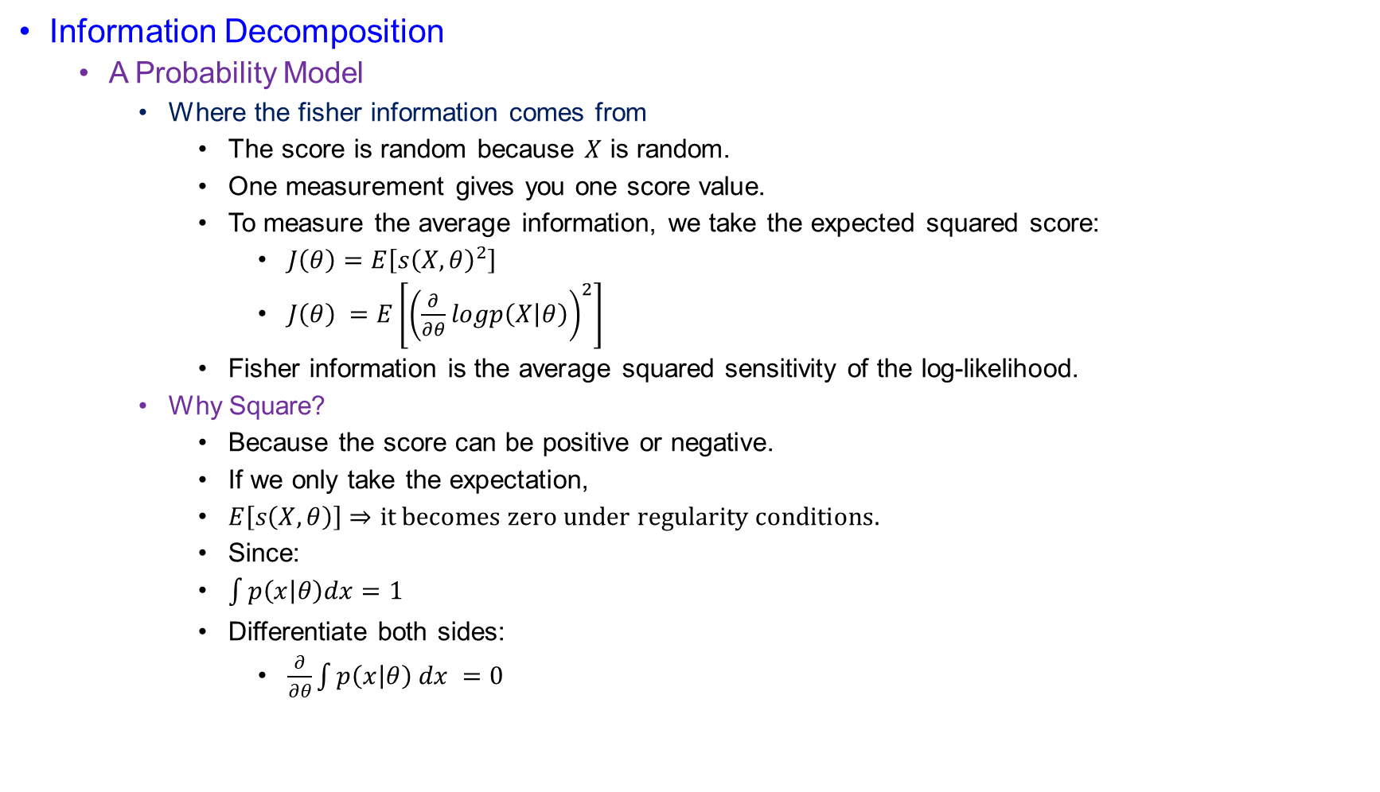
PCRB for Tracking or Filtering
Information Decomposition
  A Probability Model
    Where the fisher information comes from
      The score is random because $X$ is random.
      One measurement gives you one score value.
      To measure the average information, we take the expected squared score:
        $J\left(θ\right)=E\left[s{\left(X,θ\right)}^{2}\right]$
        $J\left(θ\right) =E\left[{\left(\frac{∂}{∂θ}logp\left(X | θ\right)\right)}^{2}\right]$
      Fisher information is the average squared sensitivity of the log-likelihood.
    Why Square?
      Because the score can be positive or negative.
      If we only take the expectation,
      $E\left[s\left(X,θ\right)\right]⇒it becomes zero under regularity conditions.$
      Since:
      $\int{p\left(x | θ\right)dx=1}$
      Differentiate both sides:
        $\frac{∂}{∂θ}\int{p\left(x | θ\right) dx =0}$

Slide 14

PCRB for Tracking or Filtering
Information Decomposition
  A Probability Model
    Why Square?
      Differentiate both sides:
        $\int{\frac{∂p\left(x | θ\right)}{∂θ} dx =0}$
      Now,
      $E\left[s\left(X,θ\right)\right]= \int{\frac{∂log⁡p(x|θ)}{∂θ} p\left(x | θ\right)dx}$
      $=\int{\frac{1}{p\left(x | θ\right) }\frac{∂p\left(x | θ\right)}{∂θ} p\left(x | θ\right) dx}$
      $=0$
      So, the average score is zero.
      That is why we use:
        $E\left[s^{2}\right]$ instead of $E[s]$

Slide 15
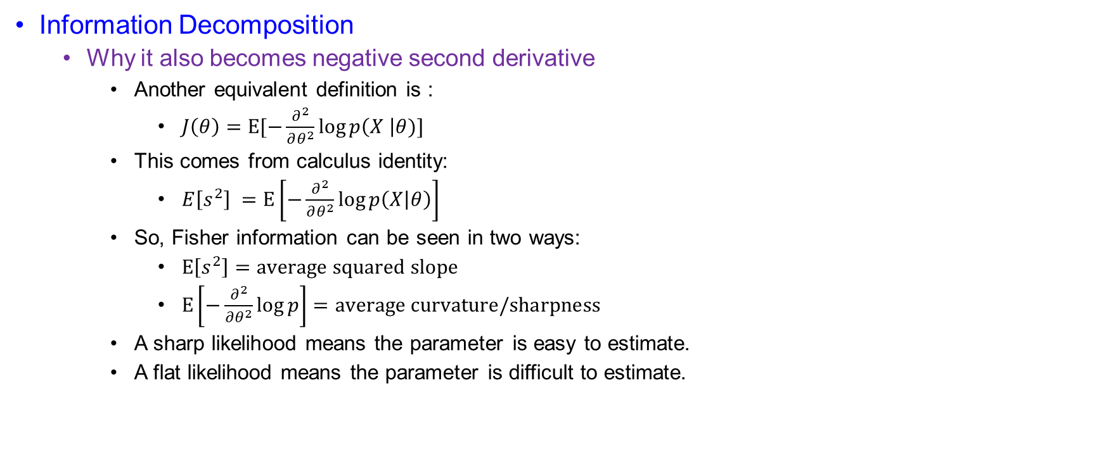
PCRB for Tracking or Filtering
Information Decomposition
  Why it also becomes negative second derivative
    Another equivalent definition is :
      $J\left(θ\right)=E[−\frac{∂^{2}}{∂θ^{2}}\log{p\left(X \right|θ)]}$
    This comes from calculus identity:
      $E\left[s^{2}\right] =E\left[−\frac{∂^{2}}{∂θ^{2}}\log{p\left(X | θ\right)}\right]$
    So, Fisher information can be seen in two ways:
      $E\left[s^{2}\right]=average squared slope$
      $E\left[−\frac{∂^{2}}{∂θ^{2}}\log{p}\right]=average curvature/sharpness$
    A sharp likelihood means the parameter is easy to estimate.
    A flat likelihood means the parameter is difficult to estimate.

Slide 16
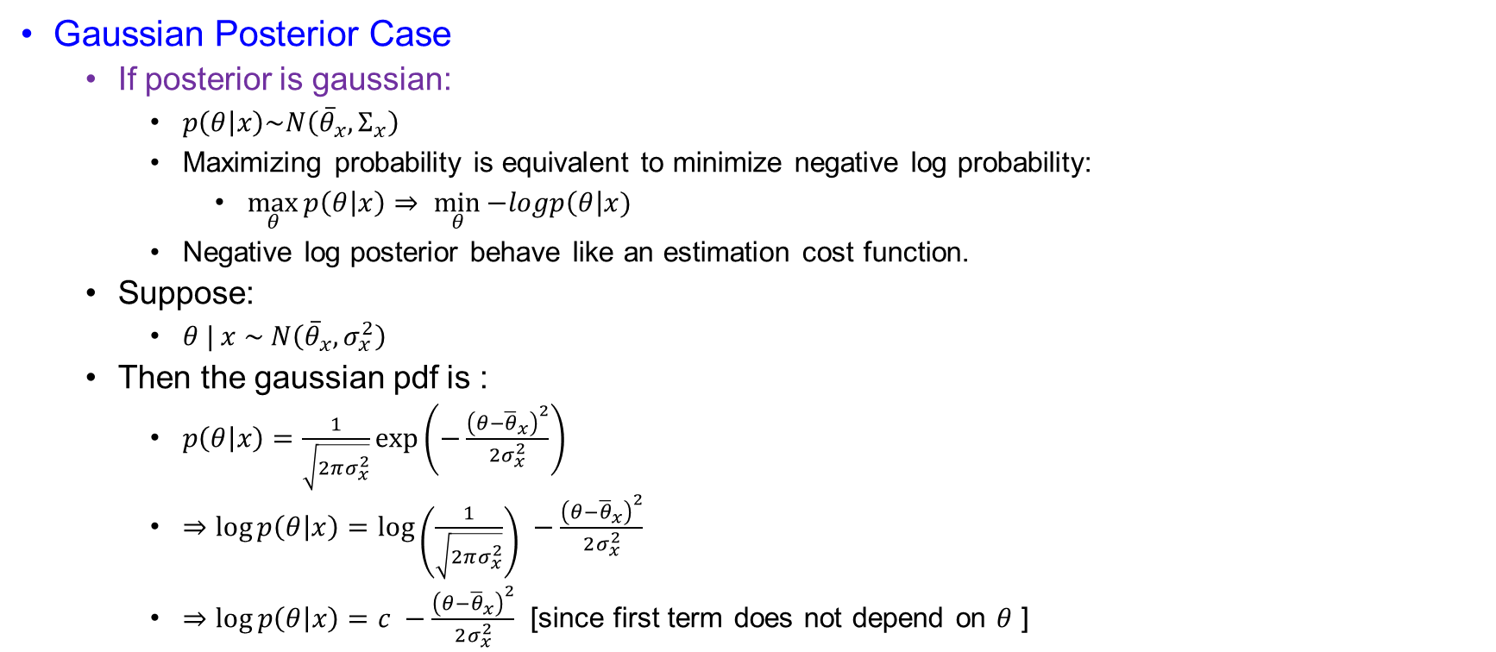
PCRB for Tracking or Filtering
Gaussian Posterior Case
  If posterior is gaussian:
    $p\left(θ | x\right)\sim N\left({\overline{θ}}_{x},Σ_{x}\right)$
    Maximizing probability is equivalent to minimize negative log probability:
      $\max_{θ}{p\left(θ | x\right)}⇒ \min_{θ}{−logp\left(θ\right|x) }$
    Negative log posterior behave like an estimation cost function.
  Suppose:
    $θ | x \sim N\left({\overline{θ}}_{x},σ_{x}^{2}\right)$
  Then the gaussian pdf is :
    $p\left(θ | x\right)=\frac{1}{\sqrt{2πσ_{x}^{2}}}\exp\left(−\frac{{\left(θ−{\overline{θ}}_{x}\right)}^{2}}{2σ_{x}^{2}}\right)$
    $⇒\log{p\left(θ | x\right)}=\log\left(\frac{1}{\sqrt{2πσ_{x}^{2}}}\right) −\frac{{\left(θ−{\overline{θ}}_{x}\right)}^{2}}{2σ_{x}^{2}}$
    $⇒$ $\log{p\left(θ | x\right)}=c −\frac{{\left(θ−{\overline{θ}}_{x}\right)}^{2}}{2σ_{x}^{2}}$ [since first term does not depend on $θ$ ]

Slide 17
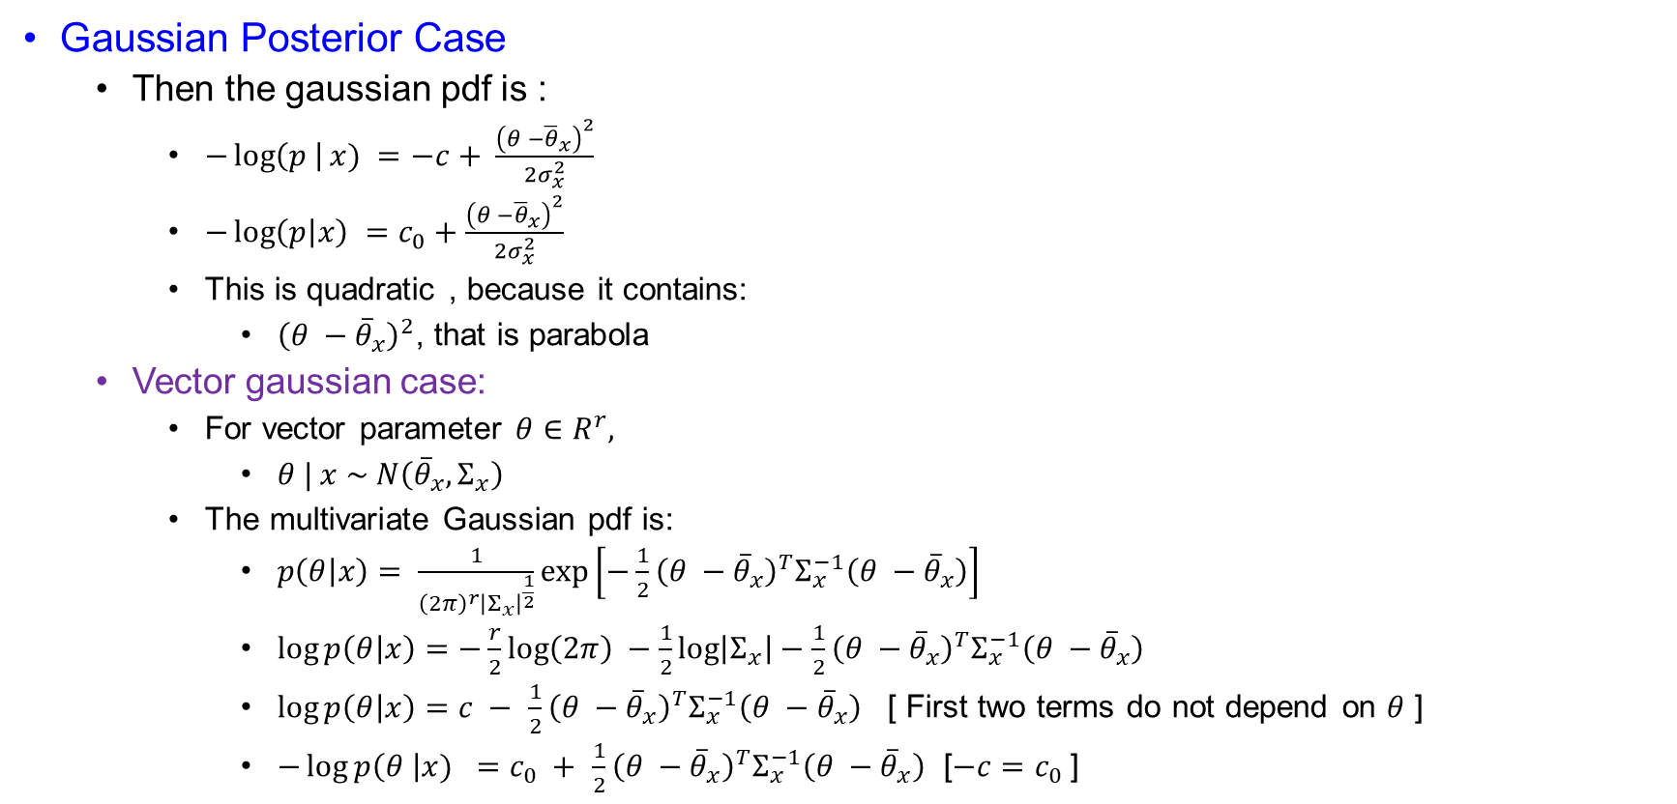
PCRB for Tracking or Filtering
Gaussian Posterior Case
  Then the gaussian pdf is :
    $−\log\left(p \right|x) =−c+ \frac{{\left(θ −{\overline{θ}}_{x}\right)}^{2}}{2σ_{x}^{2}}$
    $−\log\left(p | x\right) =c_{0}+\frac{{\left(θ −{\overline{θ}}_{x}\right)}^{2}}{2σ_{x}^{2}}$
    This is quadratic , because it contains:
      ${\left(θ −{\overline{θ}}_{x}\right)}^{2}$, that is parabola
  Vector gaussian case:
    For vector parameter $θ∈R^{r},$
      $θ | x \sim N\left({\overline{θ}}_{x},Σ_{x}\right)$
    The multivariate Gaussian pdf is:
      $p\left(θ | x\right)= \frac{1}{{\left(2π\right)}^{r}{\left|Σ_{x}\right|}^{\frac{1}{2}}}\exp\left[−\frac{1}{2}{\left(θ −{\overline{θ}}_{x}\right)}^{T}Σ_{x}^{−1}\left(θ −{\overline{θ}}_{x}\right)\right]$
      $\log{p\left(θ | x\right)}=−\frac{r}{2}\log\left(2π\right) −\frac{1}{2}\log\left|Σ_{x}\right|−\frac{1}{2}{\left(θ −{\overline{θ}}_{x}\right)}^{T}Σ_{x}^{−1}\left(θ −{\overline{θ}}_{x}\right)$
      $\log{p\left(θ | x\right)=c − }$ $\frac{1}{2}{\left(θ −{\overline{θ}}_{x}\right)}^{T}Σ_{x}^{−1}\left(θ −{\overline{θ}}_{x}\right)$ [ First two terms do not depend on $θ$ ]
      $−\log{p\left(θ \right|x) =c_{0} + }$ $\frac{1}{2}{\left(θ −{\overline{θ}}_{x}\right)}^{T}Σ_{x}^{−1}\left(θ −{\overline{θ}}_{x}\right)$ [$−c=c_{0}$]

Slide 18
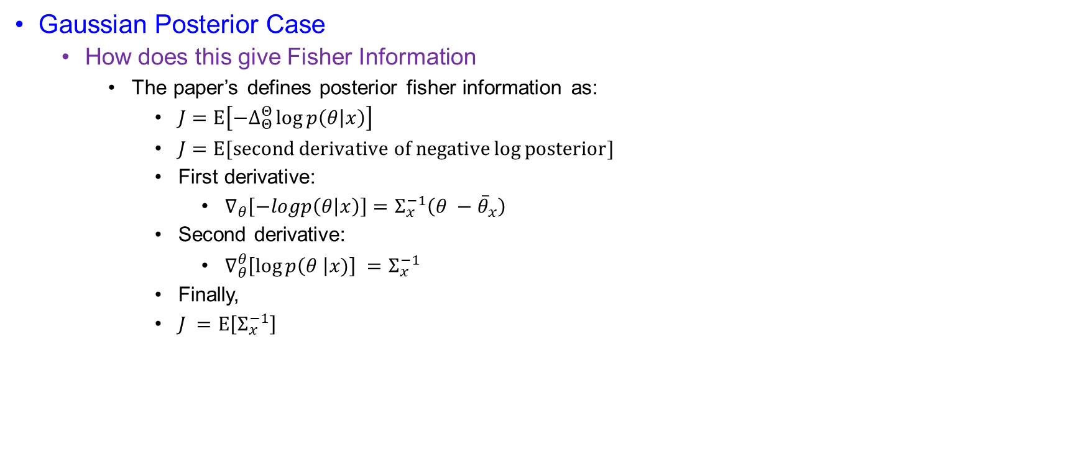
PCRB for Tracking or Filtering
Gaussian Posterior Case
  How does this give Fisher Information
    The paper’s defines posterior fisher information as:
      $J=E\left[−∆_{Θ}^{Θ}\log{p\left(θ | x\right)}\right]$
      $J=E[second derivative of negative\log{posterior}]$
      First derivative:
        $∇_{θ}\left[−logp\left(θ | x\right)\right]=Σ_{x}^{−1}\left(θ −{\overline{θ}}_{x}\right)$
      Second derivative:
        $∇_{θ}^{θ}\left[\log{p\left(θ \right|x)}\right] =Σ_{x}^{−1}$
      Finally,
      $J =E\left[Σ_{x}^{−1}\right]$

Slide 19
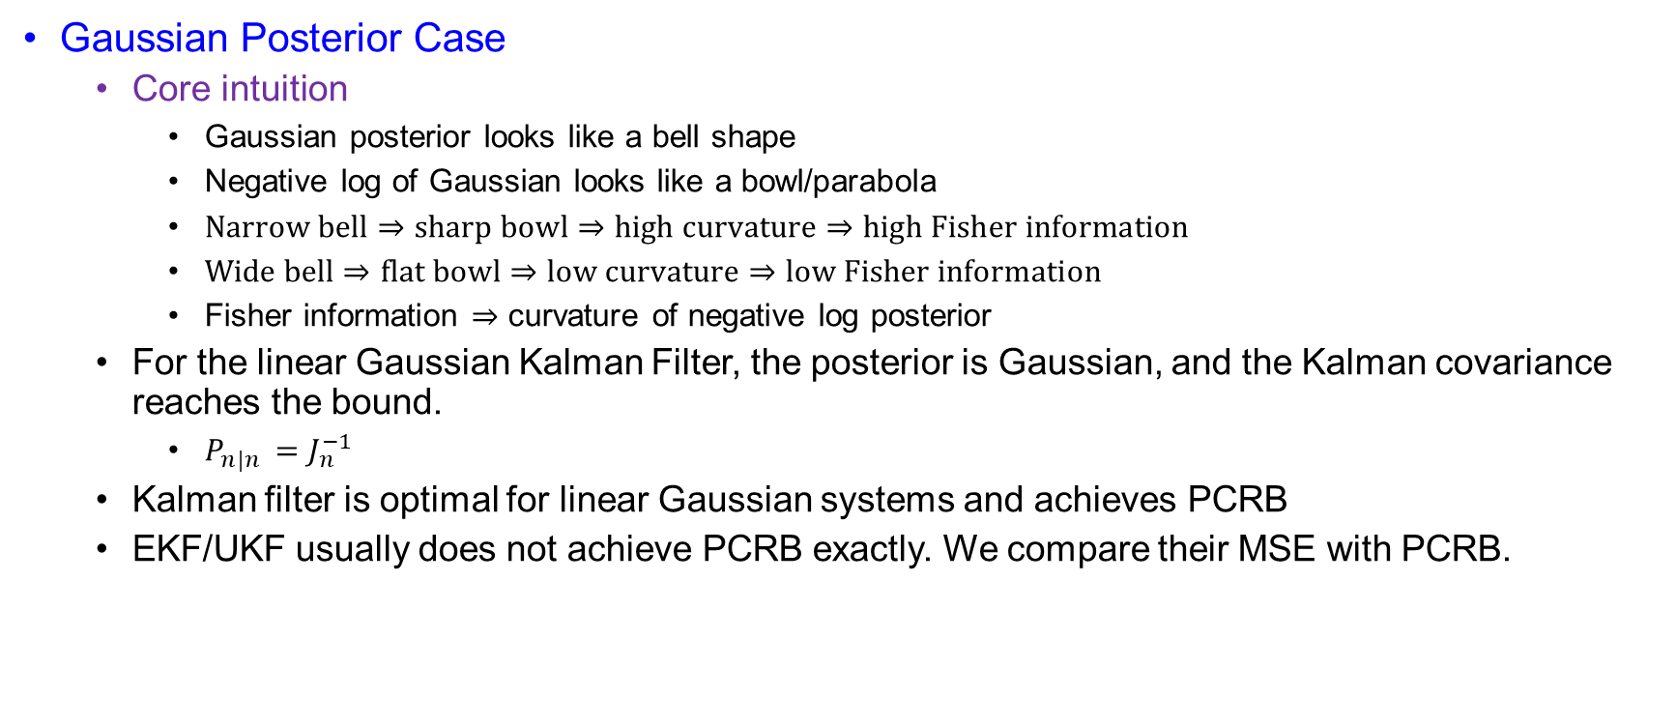
PCRB for Tracking or Filtering
Gaussian Posterior Case
  Core intuition
    Gaussian posterior looks like a bell shape
    Negative log of Gaussian looks like a bowl/parabola
    $Narrow bell⇒sharp bowl⇒high curvature⇒high Fisher information$
    $Wide bell⇒flat bowl⇒low curvature⇒low Fisher information$
    Fisher information $⇒$ curvature of negative log posterior
  For the linear Gaussian Kalman Filter, the posterior is Gaussian, and the Kalman covariance reaches the bound.
    $P_{n|n }=J_{n}^{−1}$
  Kalman filter is optimal for linear Gaussian systems and achieves PCRB
  EKF/UKF usually does not achieve PCRB exactly. We compare their MSE with PCRB.

Slide 20
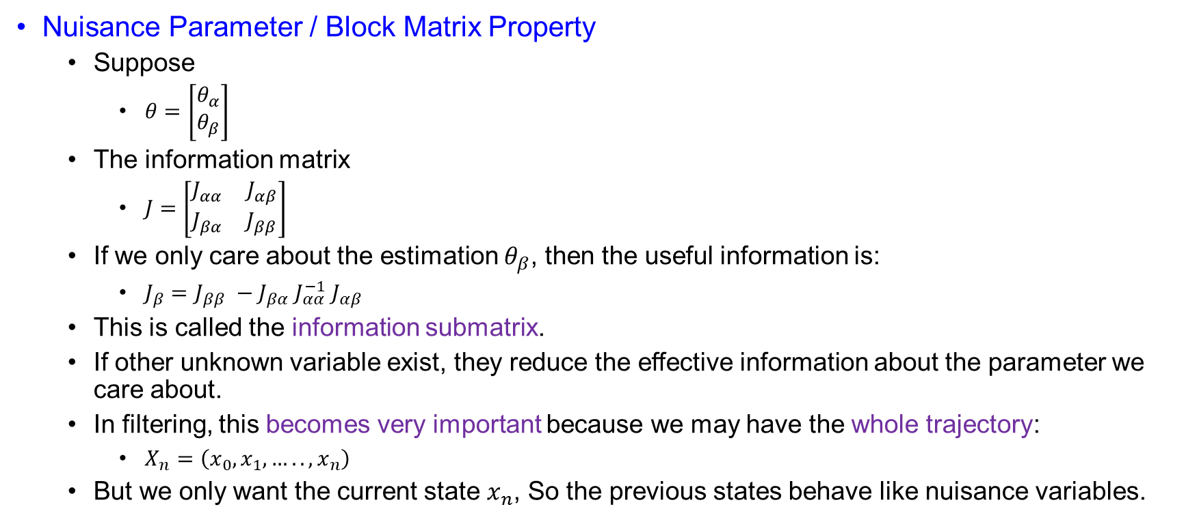
PCRB for Tracking or Filtering
Nuisance Parameter / Block Matrix Property
  Suppose
    $θ=\left[\begin{matrix}θ_{α} \\ θ_{β}\end{matrix}\right]$
  The information matrix
    $J=\left[\begin{matrix}J_{αα} & J_{αβ} \\ J_{βα} & J_{ββ}\end{matrix}\right]$
  If we only care about the estimation $θ_{β}$, then the useful information is:
    $J_{β}=J_{ββ} −J_{βα} J_{αα}^{−1} J_{αβ}$
  This is called the information submatrix.
  If other unknown variable exist, they reduce the effective information about the parameter we care about.
  In filtering, this becomes very important because we may have the whole trajectory:
    $X_{n}=\left(x_{0},x_{1},…..,x_{n}\right)$
  But we only want the current state $x_{n}$, So the previous states behave like nuisance variables.

Slide 21
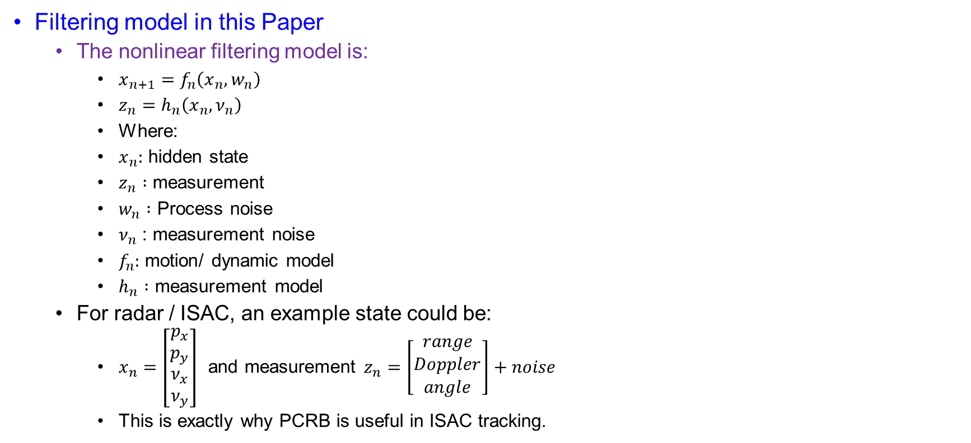
PCRB for Tracking or Filtering
Filtering model in this Paper
  The nonlinear filtering model is:
    $x_{n+1}=f_{n}\left(x_{n},w_{n}\right)$
    $z_{n}=h_{n}\left(x_{n},ν_{n}\right)$
    Where:
    $x_{n}:$ hidden state
    $z_{n} :$ measurement
    $w_{n} :$ Process noise
    $ν_{n}$ : measurement noise
    $f_{n}:$ motion/ dynamic model
    $h_{n} :$ measurement model
  For radar / ISAC, an example state could be:
    $x_{n}=\left[\begin{matrix}p_{x} \\ p_{y} \\ \begin{aligned}ν_{x} \\ ν_{y}\end{aligned}\end{matrix}\right]$ and measurement $z_{n}=\left[\begin{matrix}range \\ Doppler \\ angle\end{matrix}\right]+noise$
    This is exactly why PCRB is useful in ISAC tracking.

Slide 22
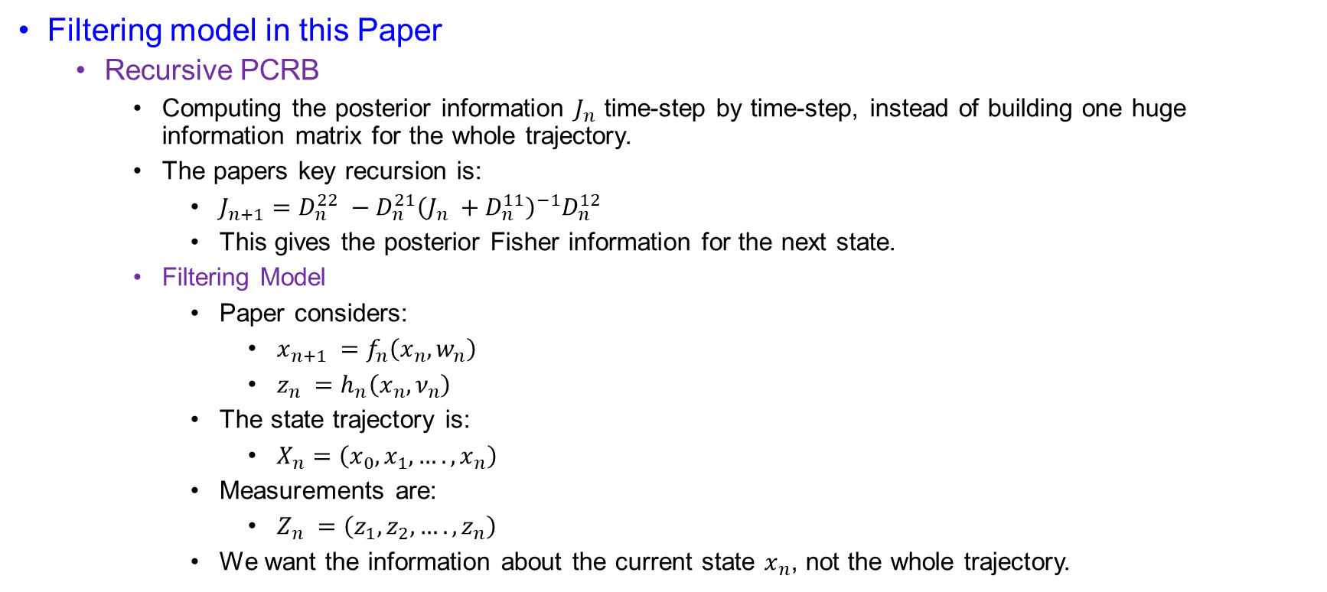
PCRB for Tracking or Filtering
Filtering model in this Paper
  Recursive PCRB
    Computing the posterior information $J_{n}$ time-step by time-step, instead of building one huge information matrix for the whole trajectory.
    The papers key recursion is:
      $J_{n+1}=D_{n}^{22} −D_{n}^{21}{\left(J_{n} +D_{n}^{11}\right)}^{−1}D_{n}^{12}$
      This gives the posterior Fisher information for the next state.
    Filtering Model
      Paper considers:
        $x_{n+1} =f_{n}\left(x_{n},w_{n}\right)$
        $z_{n} =h_{n}\left(x_{n},ν_{n}\right)$
      The state trajectory is:
        $X_{n}=\left(x_{0},x_{1},….,x_{n}\right)$
      Measurements are:
        $Z_{n} =\left(z_{1},z_{2},….,z_{n}\right)$
      We want the information about the current state $x_{n}$, not the whole trajectory.

Slide 23
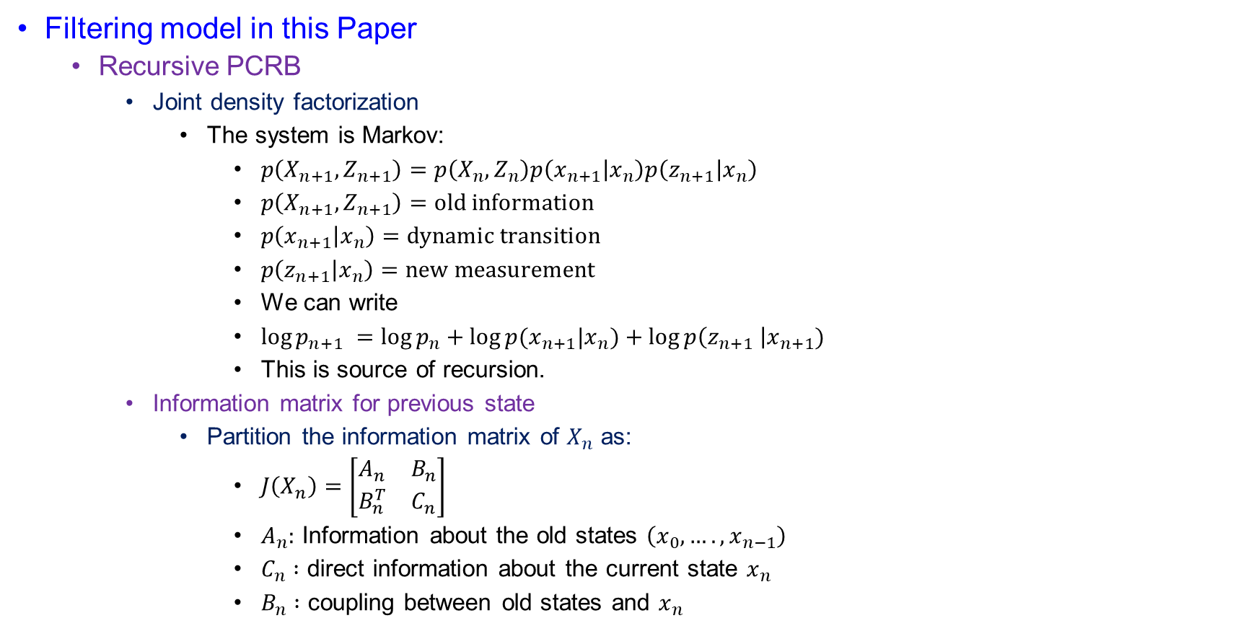
PCRB for Tracking or Filtering
Filtering model in this Paper
  Recursive PCRB
    Joint density factorization
      The system is Markov:
        $p\left(X_{n+1},Z_{n+1}\right)=p\left(X_{n},Z_{n}\right)p\left(x_{n+1} | x_{n}\right)p\left(z_{n+1} | x_{n}\right)$
        $p\left(X_{n+1},Z_{n+1}\right)=old information$
        $p\left(x_{n+1} | x_{n}\right)=dynamic transition$
        $p\left(z_{n+1} | x_{n}\right)=new measurement$
        We can write
        $\log{p_{n+1} =\log{p_{n}}+\log{p(x_{n+1}|x_{n})}+\log{p\left(z_{n+1} \right|x_{n+1}) }}$
        This is source of recursion.
    Information matrix for previous state
      Partition the information matrix of $X_{n}$ as:
        $J\left(X_{n}\right)=\left[\begin{matrix}A_{n} & B_{n} \\ B_{n}^{T} & C_{n}\end{matrix}\right]$
        $A_{n}:$ Information about the old states $\left(x_{0},….,x_{n−1}\right)$
        $C_{n} :$ direct information about the current state $x_{n}$
        $B_{n} :$ coupling between old states and $x_{n}$

Slide 24
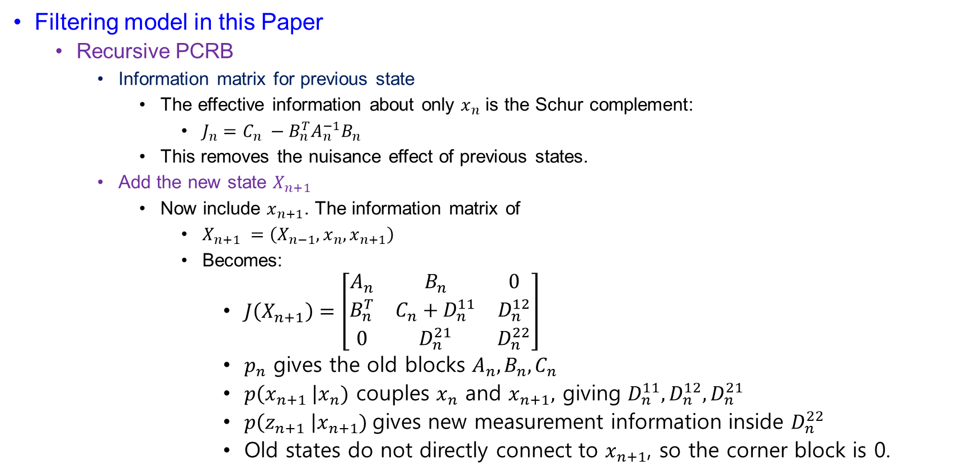
PCRB for Tracking or Filtering
Filtering model in this Paper
  Recursive PCRB
    Information matrix for previous state
      The effective information about only $x_{n}$ is the Schur complement:
        $J_{n}=C_{n} −B_{n}^{T}A_{n}^{−1}B_{n}$
      This removes the nuisance effect of previous states.
    Add the new state $X_{n+1}$
      Now include $x_{n+1}$. The information matrix of
        $X_{n+1} =\left(X_{n−1},x_{n},x_{n+1}\right)$
        Becomes:
          $J\left(X_{n+1}\right)=\left[\begin{matrix}A_{n} & B_{n} & 0 \\ B_{n}^{T} & C_{n}+D_{n}^{11} & D_{n}^{12} \\ 0 & D_{n}^{21} & D_{n}^{22}\end{matrix}\right]$
          $p_{n}$ gives the old blocks $A_{n}, B_{n}, C_{n}$
          $p\left(x_{n+1} \right|x_{n})$ couples $x_{n}$ and $x_{n+1},$ giving $D_{n}^{11}, D_{n}^{12},D_{n}^{21}$
          $p\left(z_{n+1} \right|x_{n+1})$gives new measurement information inside $D_{n}^{22}$
          Old states do not directly connect to $x_{n+1}$, so the corner block is 0.

Slide 25
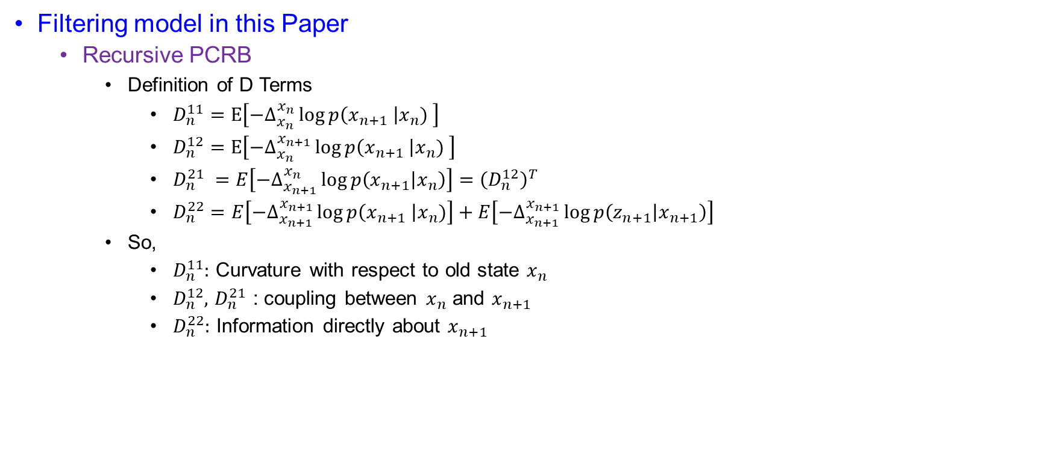
PCRB for Tracking or Filtering
Filtering model in this Paper
  Recursive PCRB
    Definition of D Terms
      $D_{n}^{11}=E\left[−∆_{x_{n}}^{x_{n}}\log{p\left(x_{n+1} \right|x_{n}) }\right]$
      $D_{n}^{12}=E\left[−∆_{x_{n}}^{x_{n+1}}\log{p\left(x_{n+1} \right|x_{n}) }\right]$
      $D_{n}^{21} =E\left[−∆_{x_{n+1}}^{x_{n}}\log{p\left(x_{n+1} | x_{n}\right)}\right]={\left(D_{n}^{12}\right)}^{T}$
      $D_{n}^{22}=E\left[−∆_{x_{n+1}}^{x_{n+1}}\log{p\left(x_{n+1} \right|x_{n})}\right]+E\left[−∆_{x_{n+1}}^{x_{n+1}}\log{p\left(z_{n+1} | x_{n+1}\right)}\right]$
    So,
      $D_{n}^{11}:$ Curvature with respect to old state $x_{n}$
      $D_{n}^{12},$ $D_{n}^{21}$ : coupling between $x_{n}$ and $x_{n+1}$
      $D_{n}^{22}:$ Information directly about $x_{n+1}$

Slide 26
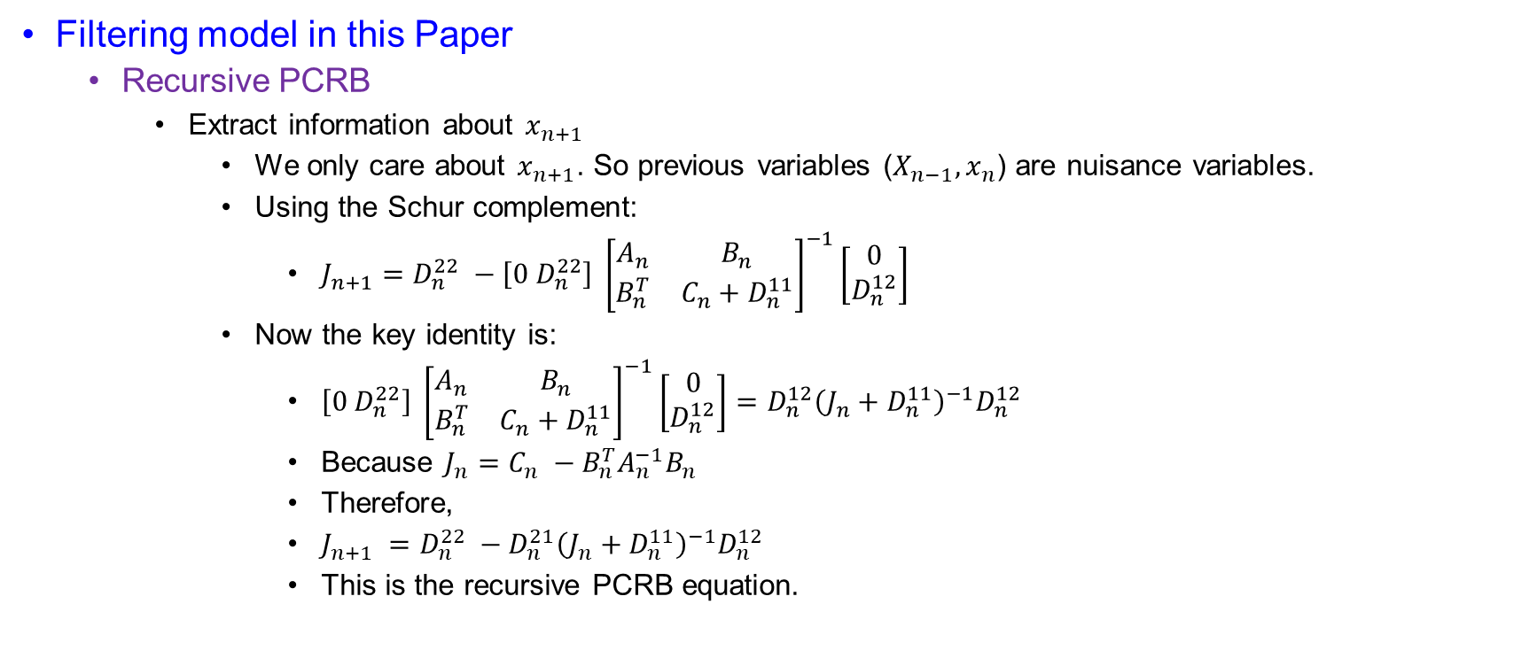
PCRB for Tracking or Filtering
Filtering model in this Paper
  Recursive PCRB
    Extract information about $x_{n+1}$
      We only care about $x_{n+1}$. So previous variables ($X_{n−1},x_{n}$) are nuisance variables.
      Using the Schur complement:
        $J_{n+1}=D_{n}^{22} −\left[0 D_{n}^{22}\right] {\left[\begin{matrix}A_{n} & B_{n} \\ B_{n}^{T} & C_{n}+D_{n}^{11}\end{matrix}\right]}^{−1}\left[\begin{matrix}0 \\ D_{n}^{12}\end{matrix}\right]$
      Now the key identity is:
        $\left[0 D_{n}^{22}\right] {\left[\begin{matrix}A_{n} & B_{n} \\ B_{n}^{T} & C_{n}+D_{n}^{11}\end{matrix}\right]}^{−1}\left[\begin{matrix}0 \\ D_{n}^{12}\end{matrix}\right]=D_{n}^{12}{\left(J_{n}+D_{n}^{11}\right)}^{−1}D_{n}^{12}$
        Because $J_{n}=C_{n} −B_{n}^{T}A_{n}^{−1}B_{n}$
        Therefore,
        $J_{n+1} =D_{n}^{22} −D_{n}^{21}{\left(J_{n}+D_{n}^{11}\right)}^{−1}D_{n}^{12}$
        This is the recursive PCRB equation.

Slide 27
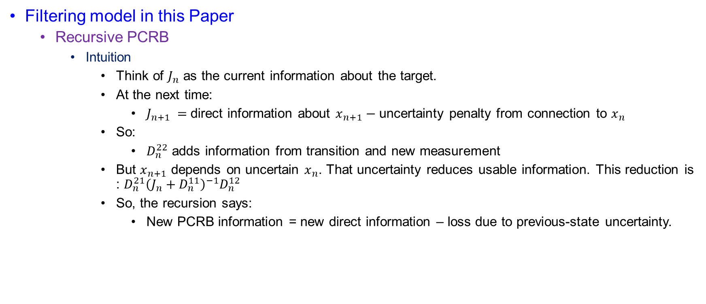
PCRB for Tracking or Filtering
Filtering model in this Paper
  Recursive PCRB
    Intuition
      Think of $J_{n}$ as the current information about the target.
      At the next time:
        $J_{n+1} =$direct information about $x_{n+1}−$ uncertainty penalty from connection to $x_{n}$
      So:
        $D_{n}^{22}$ adds information from transition and new measurement
      But $x_{n+1}$ depends on uncertain $x_{n}$. That uncertainty reduces usable information. This reduction is : $D_{n}^{21}{\left(J_{n}+D_{n}^{11}\right)}^{−1}D_{n}^{12}$
      So, the recursion says:
        New PCRB information = new direct information – loss due to previous-state uncertainty.

Slide 28
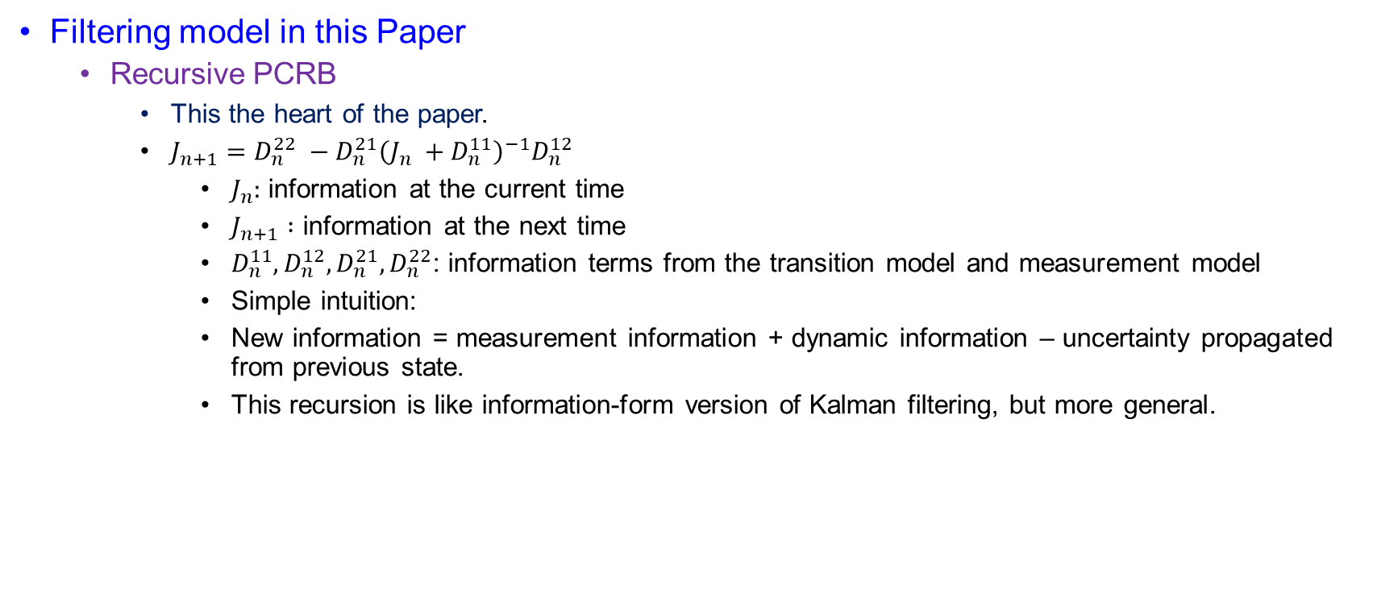
PCRB for Tracking or Filtering
Filtering model in this Paper
  Recursive PCRB
    This the heart of the paper.
    $J_{n+1}=D_{n}^{22} −D_{n}^{21}{\left(J_{n} +D_{n}^{11}\right)}^{−1}D_{n}^{12}$
      $J_{n}:$ information at the current time
      $J_{n+1} :$ information at the next time
      $D_{n}^{11},D_{n}^{12},D_{n}^{21},D_{n}^{22}$: information terms from the transition model and measurement model
      Simple intuition:
      New information = measurement information + dynamic information – uncertainty propagated from previous state.
      This recursion is like information-form version of Kalman filtering, but more general.

Slide 29
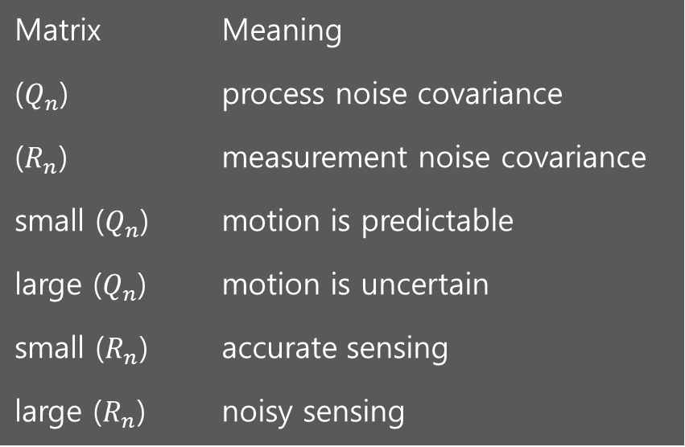
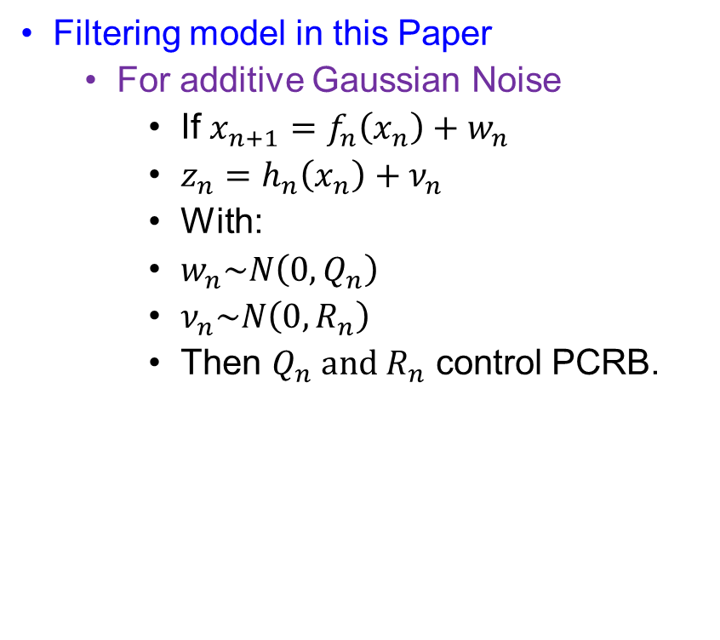
PCRB for Tracking or Filtering
Filtering model in this Paper
  For additive Gaussian Noise
    If $x_{n+1}=f_{n}\left(x_{n}\right)+w_{n}$
    $z_{n}=h_{n}\left(x_{n}\right)+ν_{n}$
    With:
    $w_{n}\sim N\left(0,Q_{n}\right)$
    $ν_{n}\sim N\left(0,R_{n}\right)$
    Then $Q_{n} and R_{n}$ control PCRB.
Matrix | Meaning
($Q_{n}$) | process noise covariance
($R_{n}$) | measurement noise covariance
small ($Q_{n}$) | motion is predictable
large ($Q_{n}$) | motion is uncertain
small ($R_{n}$) | accurate sensing
large ($R_{n}$) | noisy sensing

Slide 30
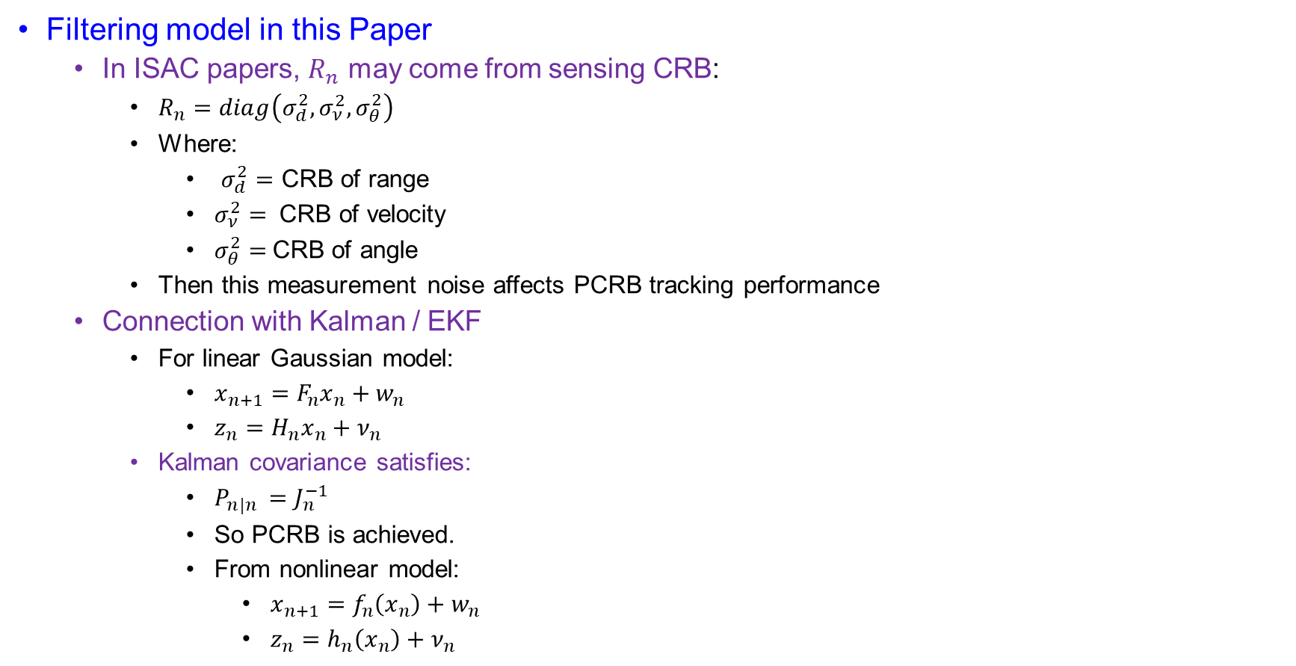
PCRB for Tracking or Filtering
Filtering model in this Paper
  In ISAC papers, $R_{n}$ may come from sensing CRB:
    $R_{n}=diag\left(σ_{d}^{2},σ_{ν}^{2},σ_{θ}^{2}\right)$
    Where:
      $σ_{d}^{2}=$ CRB of range
      $σ_{ν}^{2}=$ CRB of velocity
      $σ_{θ}^{2}=$CRB of angle
    Then this measurement noise affects PCRB tracking performance
  Connection with Kalman / EKF
    For linear Gaussian model:
      $x_{n+1}=F_{n}x_{n}+w_{n}$
      $z_{n}=H_{n}x_{n}+ν_{n}$
    Kalman covariance satisfies:
      $P_{n|n }=J_{n}^{−1}$
      So PCRB is achieved.
      From nonlinear model:
        $x_{n+1}=f_{n}\left(x_{n}\right)+w_{n}$
        $z_{n}=h_{n}\left(x_{n}\right)+ν_{n}$

Slide 31
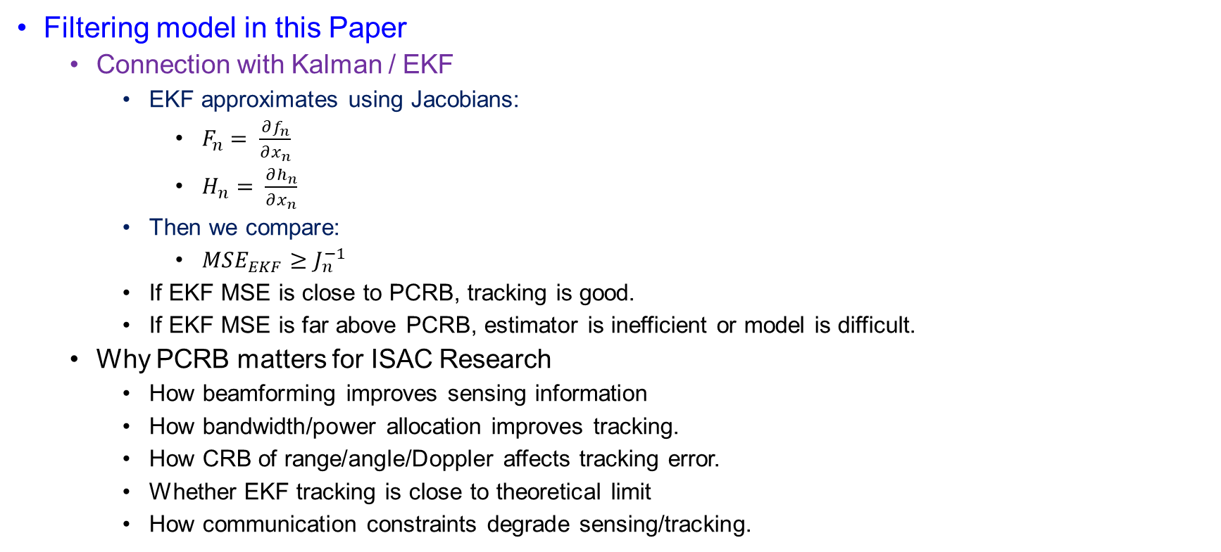
PCRB for Tracking or Filtering
Filtering model in this Paper
  Connection with Kalman / EKF
    EKF approximates using Jacobians:
      $F_{n}= \frac{∂f_{n}}{∂x_{n}}$
      $H_{n}= \frac{∂h_{n}}{∂x_{n}}$
    Then we compare:
      $MSE_{EKF}≥J_{n}^{−1}$
    If EKF MSE is close to PCRB, tracking is good.
    If EKF MSE is far above PCRB, estimator is inefficient or model is difficult.
  Why PCRB matters for ISAC Research
    How beamforming improves sensing information
    How bandwidth/power allocation improves tracking.
    How CRB of range/angle/Doppler affects tracking error.
    Whether EKF tracking is close to theoretical limit
    How communication constraints degrade sensing/tracking.

Slide 32

Regularity boundary
Goal
  Why Does the First Term Become Zero?
  We want to show:
  $\iint{\frac{∂^{2}p\left(x , θ\right)}{∂θ_{i}∂θ_{j}}} dx dθ=0$
  where:
  $p\left(x , θ\right)=p_{X,Θ}\left(x , θ\right)$
  This term appears when deriving the equivalence between:
  $J_{ij}=𝔼\left[\frac{∂\log{p}}{∂θ_{i}}\frac{∂\log{p}}{∂θ_{j}}\right]$
  and
  $J_{ij}=𝔼\left[−\frac{∂^{2}\log{p}}{∂θ_{i}∂θ_{j}}\right]$

Slide 33

Regularity boundary
Start From The Second Derivative
  Using the derivative identity:
  $\frac{∂^{2}\log{p}}{∂θ_{i}∂θ_{j}}=\frac{1}{p}\frac{∂^{2}p}{∂θ_{i}∂θ_{j}}−\frac{1}{p^{2}}\frac{∂p}{∂θ_{i}}\frac{∂p}{∂θ_{j}}$
  Taking expectation:
  $𝔼\left[\frac{∂^{2}\log{p}}{∂θ_{i}∂θ_{j}}\right]=\iint{p}\left[\frac{1}{p}\frac{∂^{2}p}{∂θ_{i}∂θ_{j}}−\frac{1}{p^{2}}\frac{∂p}{∂θ_{i}}\frac{∂p}{∂θ_{j}}\right]dx dθ$
  So:
  $=\iint{\frac{∂^{2}p}{∂θ_{i}∂θ_{j}}}dx dθ−\iint{\frac{1}{p}}\frac{∂p}{∂θ_{i}}\frac{∂p}{∂θ_{j}}dx dθ$

Slide 34

Regularity Condition
Focus On The First Term
  The first term is:
    $T_{1}=\iint{\frac{∂^{2}p\left(x , θ\right)}{∂θ_{i}∂θ_{j}}}dx dθ$
    Write:
    $\frac{∂^{2}p}{∂θ_{i}∂θ_{j}}=\frac{∂}{∂θ_{j}}\left(\frac{∂p}{∂θ_{i}}\right)$
    Therefore:
    $T_{1}=\iint{\frac{∂}{∂θ_{j}}}\left(\frac{∂p\left(x , θ\right)}{∂θ_{i}}\right)dx dθ$
    Now integrate with respect to $θ_{j}$.

Slide 35

Regularity Condition
Boundary Calculation
  Assume:
    $θ_{j}∈\left(− , ∞∞\right)$
    Then:
    $\int_{−∞}^{∞}{\frac{∂}{∂θ_{j}}}\left(\frac{∂p\left(x , θ\right)}{∂θ_{i}}\right)dθ_{j}={\left[\frac{∂p\left(x , θ\right)}{∂θ_{i}}\right]}_{θ_{j}=−∞}^{θ_{j}=∞}$
  So:
    $=\lim_{θ_{j}→∞}\frac{∂p\left(x , θ\right)}{∂θ_{i}}−\lim_{θ_{j}→−∞}\frac{∂p\left(x , θ\right)}{∂θ_{i}}$
    Under regularity/boundary conditions:
    $\lim_{θ_{j}→∞}\frac{∂p\left(x , θ\right)}{∂θ_{i}}=0$
    $\lim_{θ_{j}→−∞}\frac{∂p\left(x , θ\right)}{∂θ_{i}}=0$
  Therefore:
    $T_{1}=0−0=0$

Slide 36
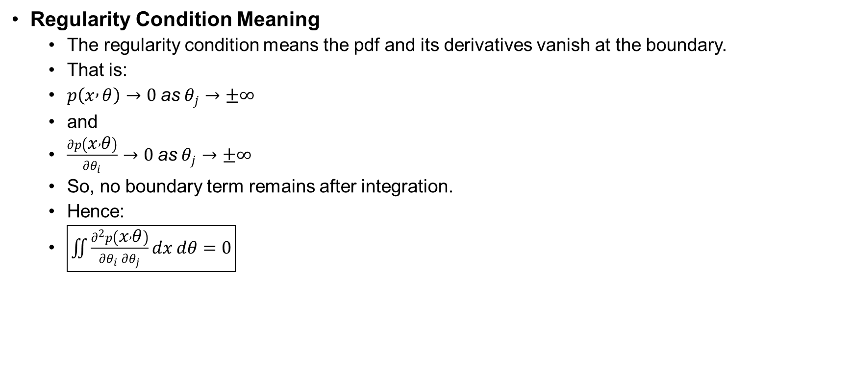
Regularity Condition
Regularity Condition Meaning
  The regularity condition means the pdf and its derivatives vanish at the boundary.
  That is:
  $p\left(x , θ\right)→0 \text{as} θ_{j}→±∞$
  and
  $\frac{∂p\left(x , θ\right)}{∂θ_{i}}→0 \text{as} θ_{j}→±∞$
  So, no boundary term remains after integration.
  Hence:
  $\boxed{\iint{\frac{∂^{2}p\left(x , θ\right)}{∂θ_{i}∂θ_{j}}}dx dθ=0}$

Slide 37
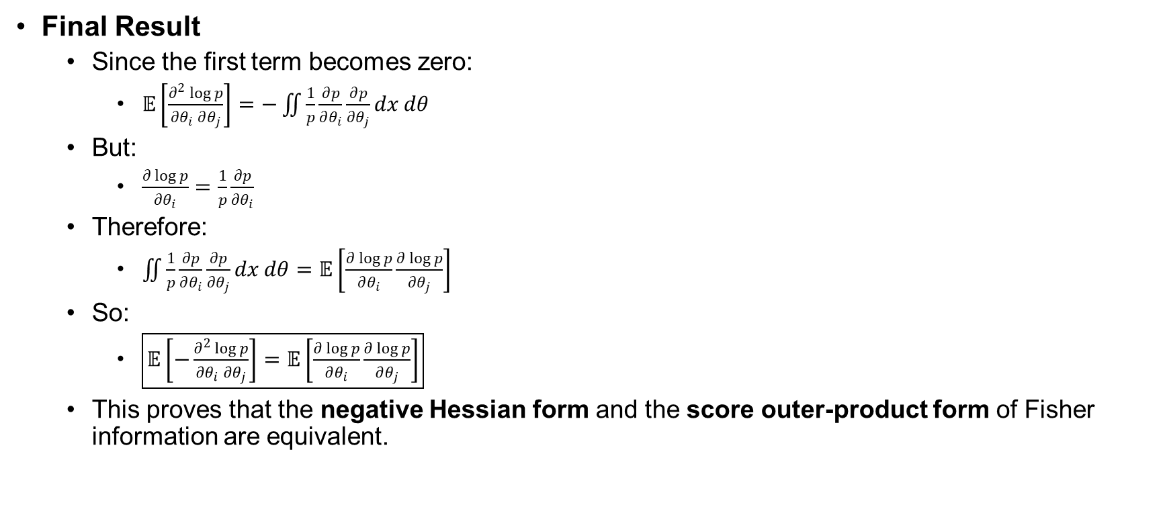
Regularity Condition
Final Result
  Since the first term becomes zero:
    $𝔼\left[\frac{∂^{2}\log{p}}{∂θ_{i}∂θ_{j}}\right]=−\iint{\frac{1}{p}}\frac{∂p}{∂θ_{i}}\frac{∂p}{∂θ_{j}}dx dθ$
  But:
    $\frac{∂\log{p}}{∂θ_{i}}=\frac{1}{p}\frac{∂p}{∂θ_{i}}$
  Therefore:
    $\iint{\frac{1}{p}}\frac{∂p}{∂θ_{i}}\frac{∂p}{∂θ_{j}}dx dθ=𝔼\left[\frac{∂\log{p}}{∂θ_{i}}\frac{∂\log{p}}{∂θ_{j}}\right]$
  So:
    $\boxed{𝔼\left[−\frac{∂^{2}\log{p}}{∂θ_{i}∂θ_{j}}\right]=𝔼\left[\frac{∂\log{p}}{∂θ_{i}}\frac{∂\log{p}}{∂θ_{j}}\right]}$
  This proves that the negative Hessian form and the score outer-product form of Fisher information are equivalent.

